Slide 1

Computer Vision (CV)
Lab7
Image Segmentation
[ Unet, YoloV8 ]

Slide 2
What Is Image Segmentation?
Image segmentation is a critical process in computer vision.
Segments represent objects or parts of objects, and comprise sets of pixels, or “super-pixels”.

Slide 3
What Is Image Semantic Segmentation?
It classify all the pixels of an image into meaningful classes of objects. These classes are “semantically interpretable” and correspond to real-world categories.

Slide 4
What Is Image Instance Segmentation?
It identify each instance of each object in an image. It differs from semantic segmentation in that it doesn’t categorize every pixel.

Slide 5
Other Techniques
Thresholding
K-means Clustering
Edge Detection
divides an image into a foreground and background. A specified threshold value separates pixels into one of two levels to isolate objects. Thresholding converts grayscale images into binary images or distinguishes the lighter and darker pixels of a color image.
an algorithm identifies groups in the data, with the variable K representing the number of groups. The algorithm assigns each data point (or pixel) to one of the groups based on feature similarity. Rather than analyzing predefined groups, clustering works iteratively to organically form groups.
Identifies sharp changes or discontinuities in brightness. Edge detection usually involves arranging points of discontinuity into curved line segments, or edges. For example, the border between a block of red and a block of blue.

Slide 6
U NET
Convolutional Networks For Biomedical Image Segmentation

Slide 7
Unet Model

Slide 8
What is UpSampling2D and Conv2DTranspsoe

Slide 9
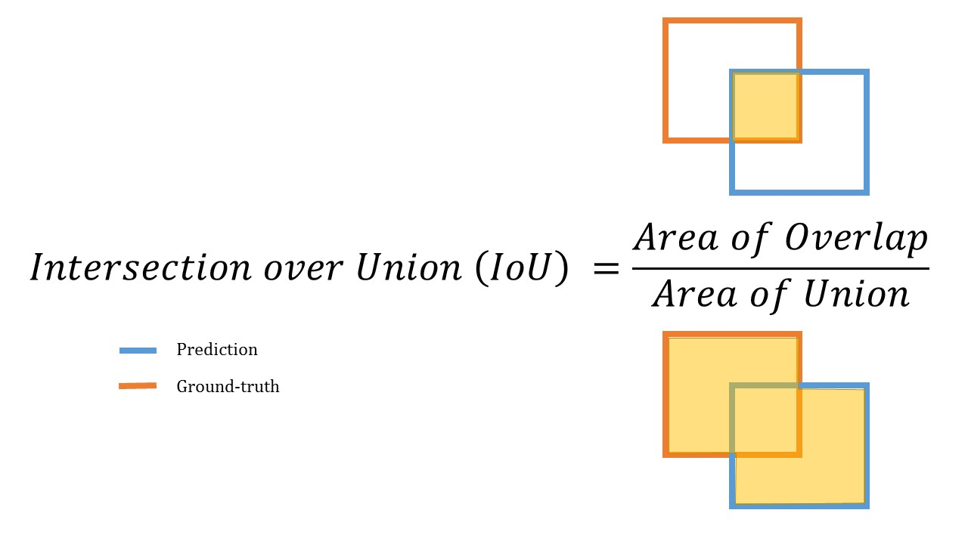
Intersection Over Union [ IOU ]

Slide 10
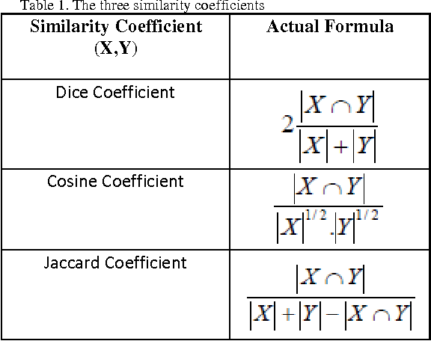
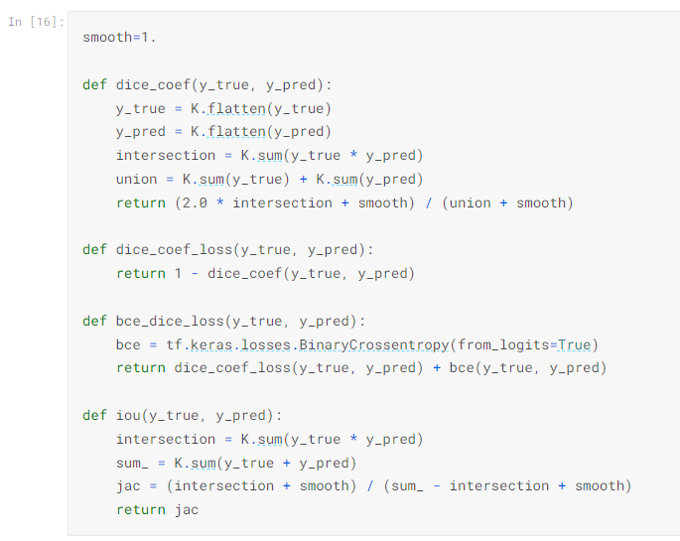
Three similarity coefficients

Slide 11
Thanks for listening

